Slide 1
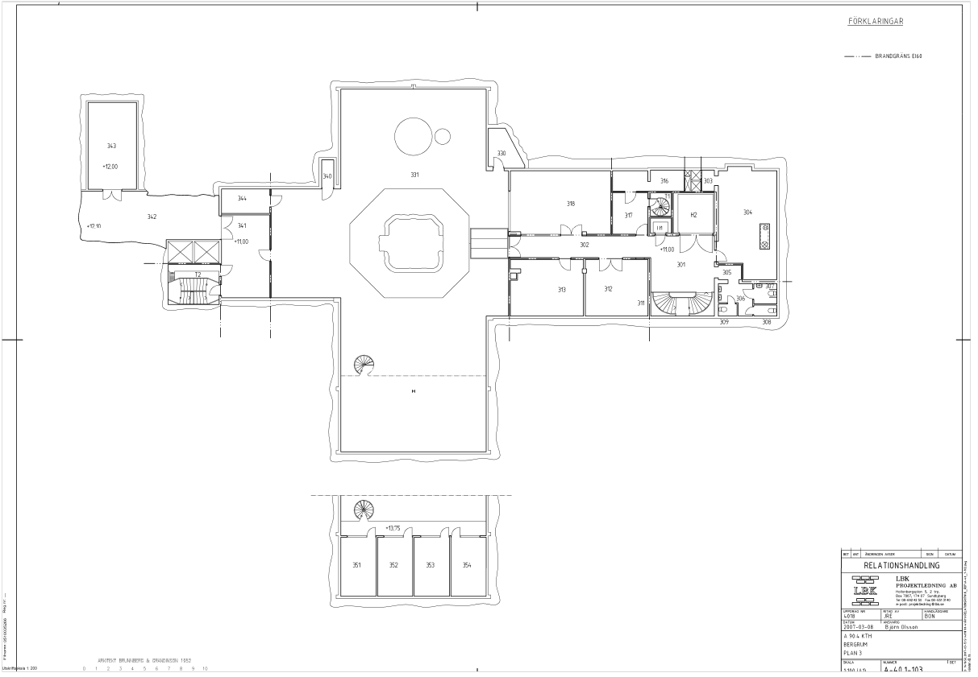
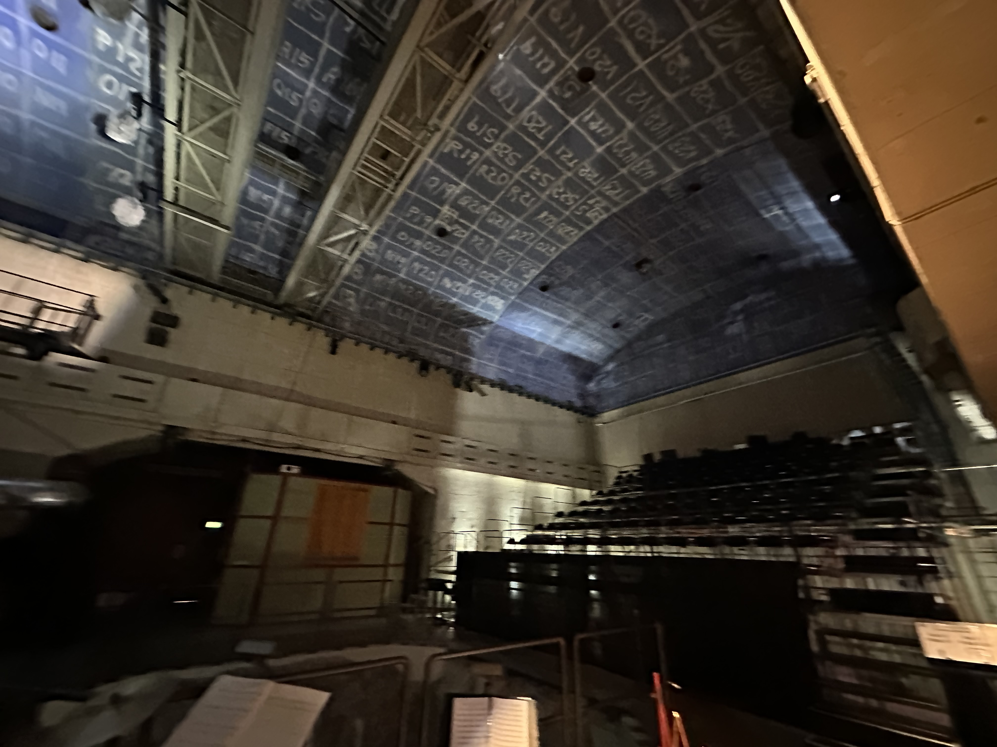
High Location Nodes (8m height)
= 5G Radio Dot (4x)
= Software Defined Radio (4x)
sdr-01
sdr-06
sdr-04
sdr-07

Slide 2
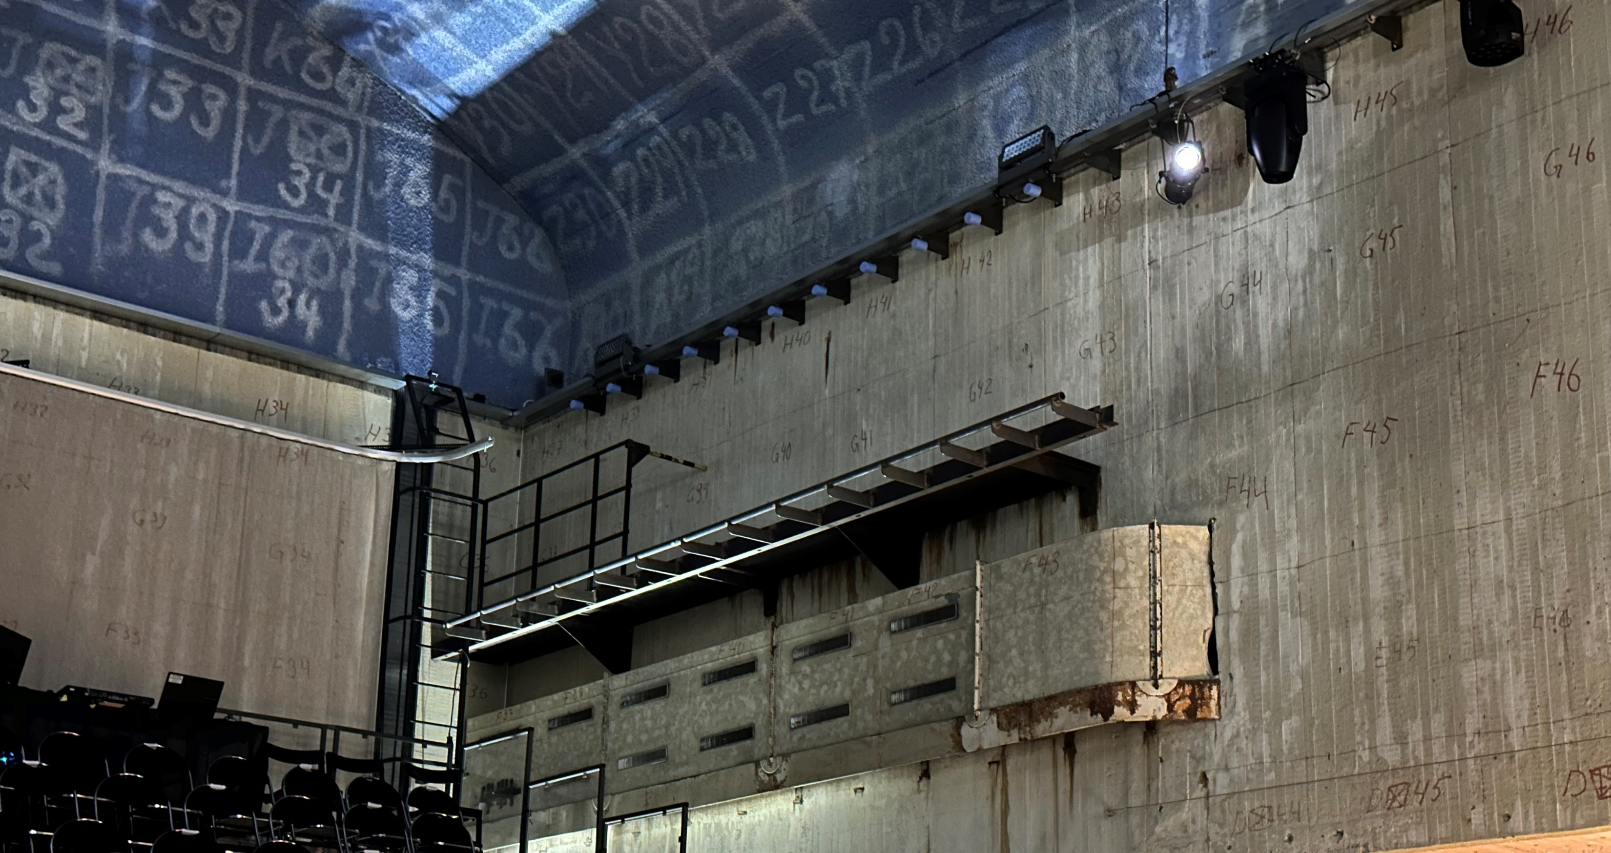
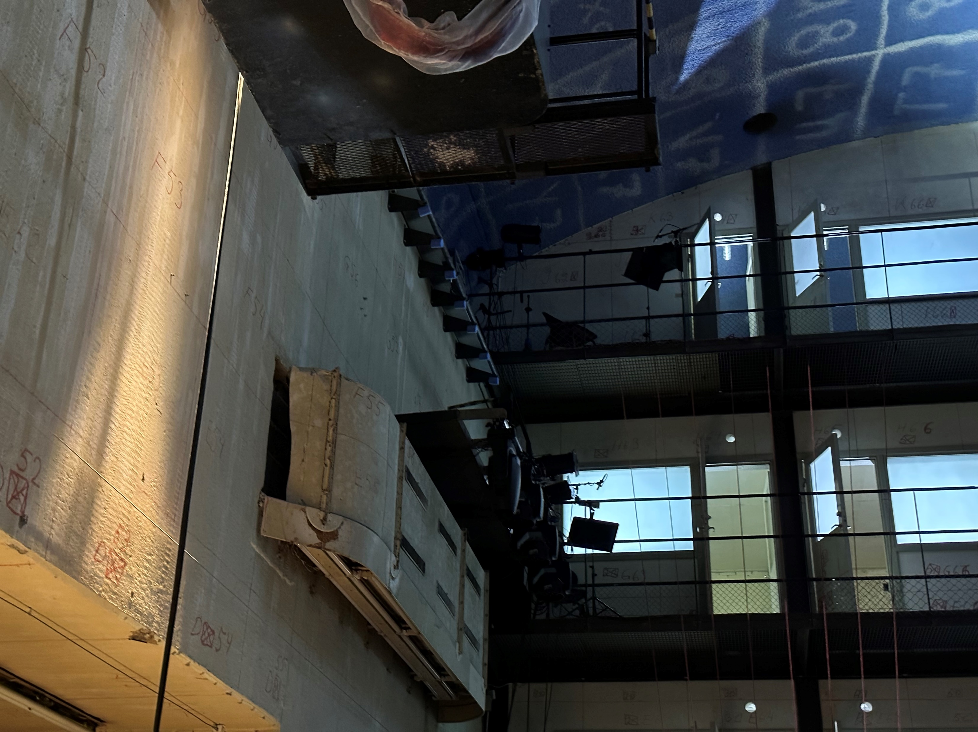
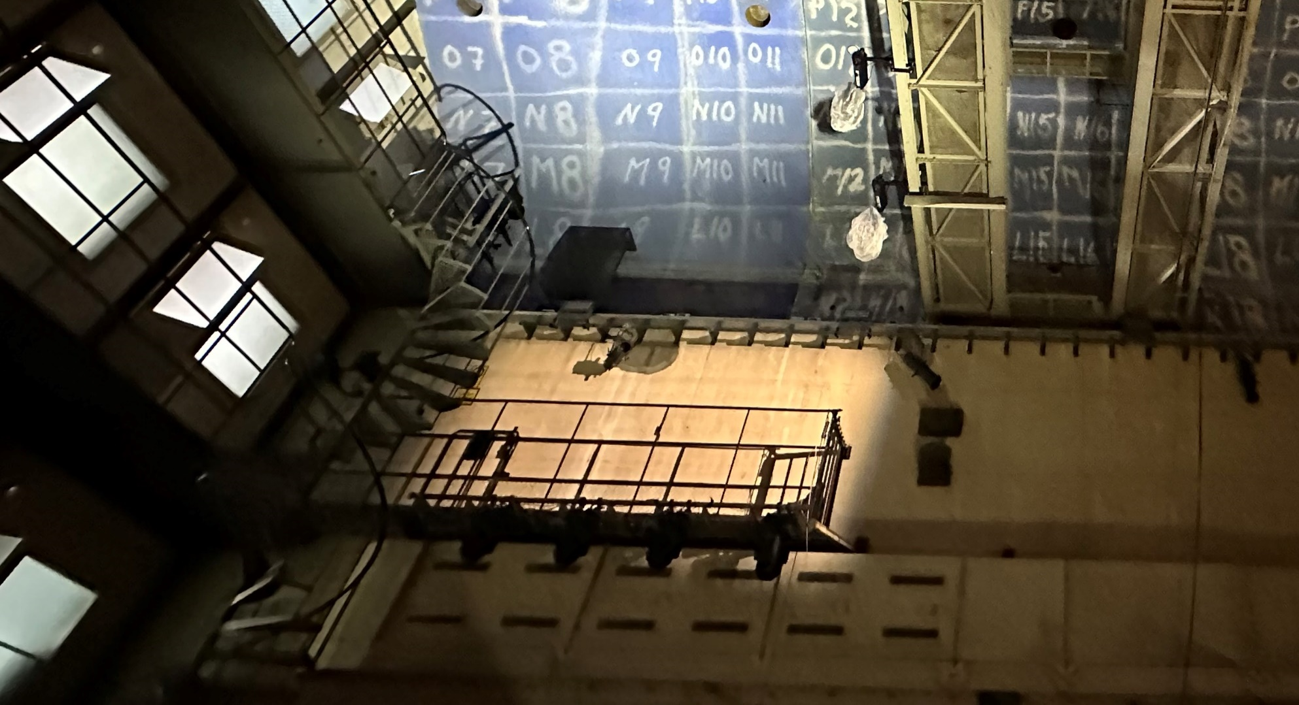
Medium Location Nodes (6m height)
= Software Defined Radio (3x)
= Advantech Router (4x)
sdr-10
adv-02
adv-01
sdr-05
adv-05
sdr-08
adv-04

Slide 3
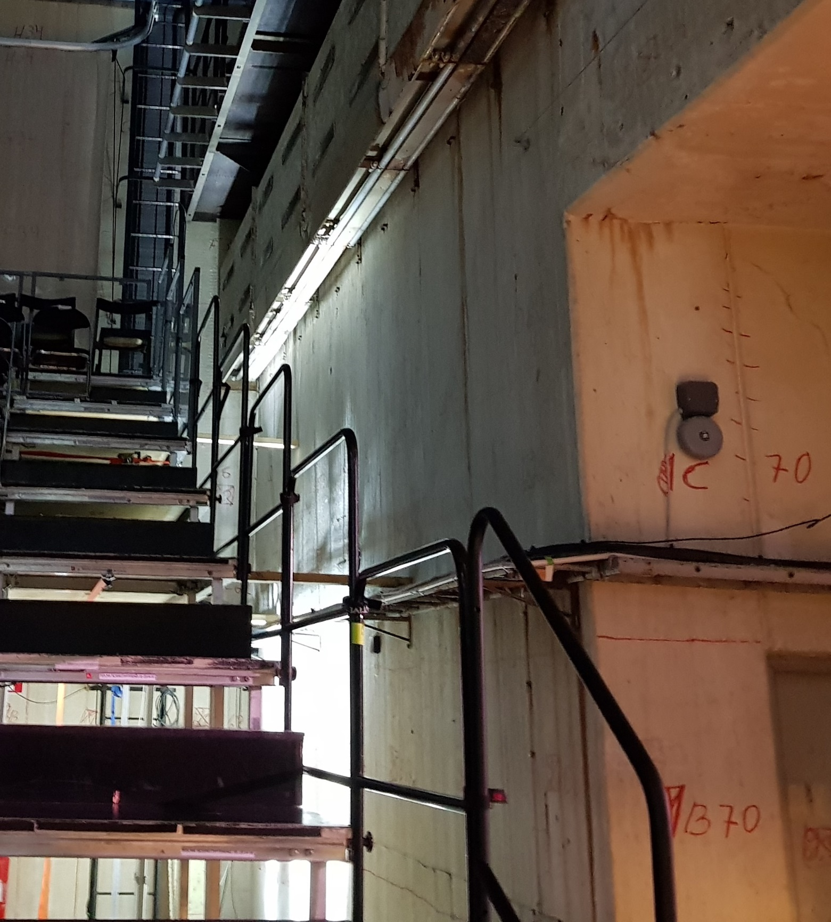
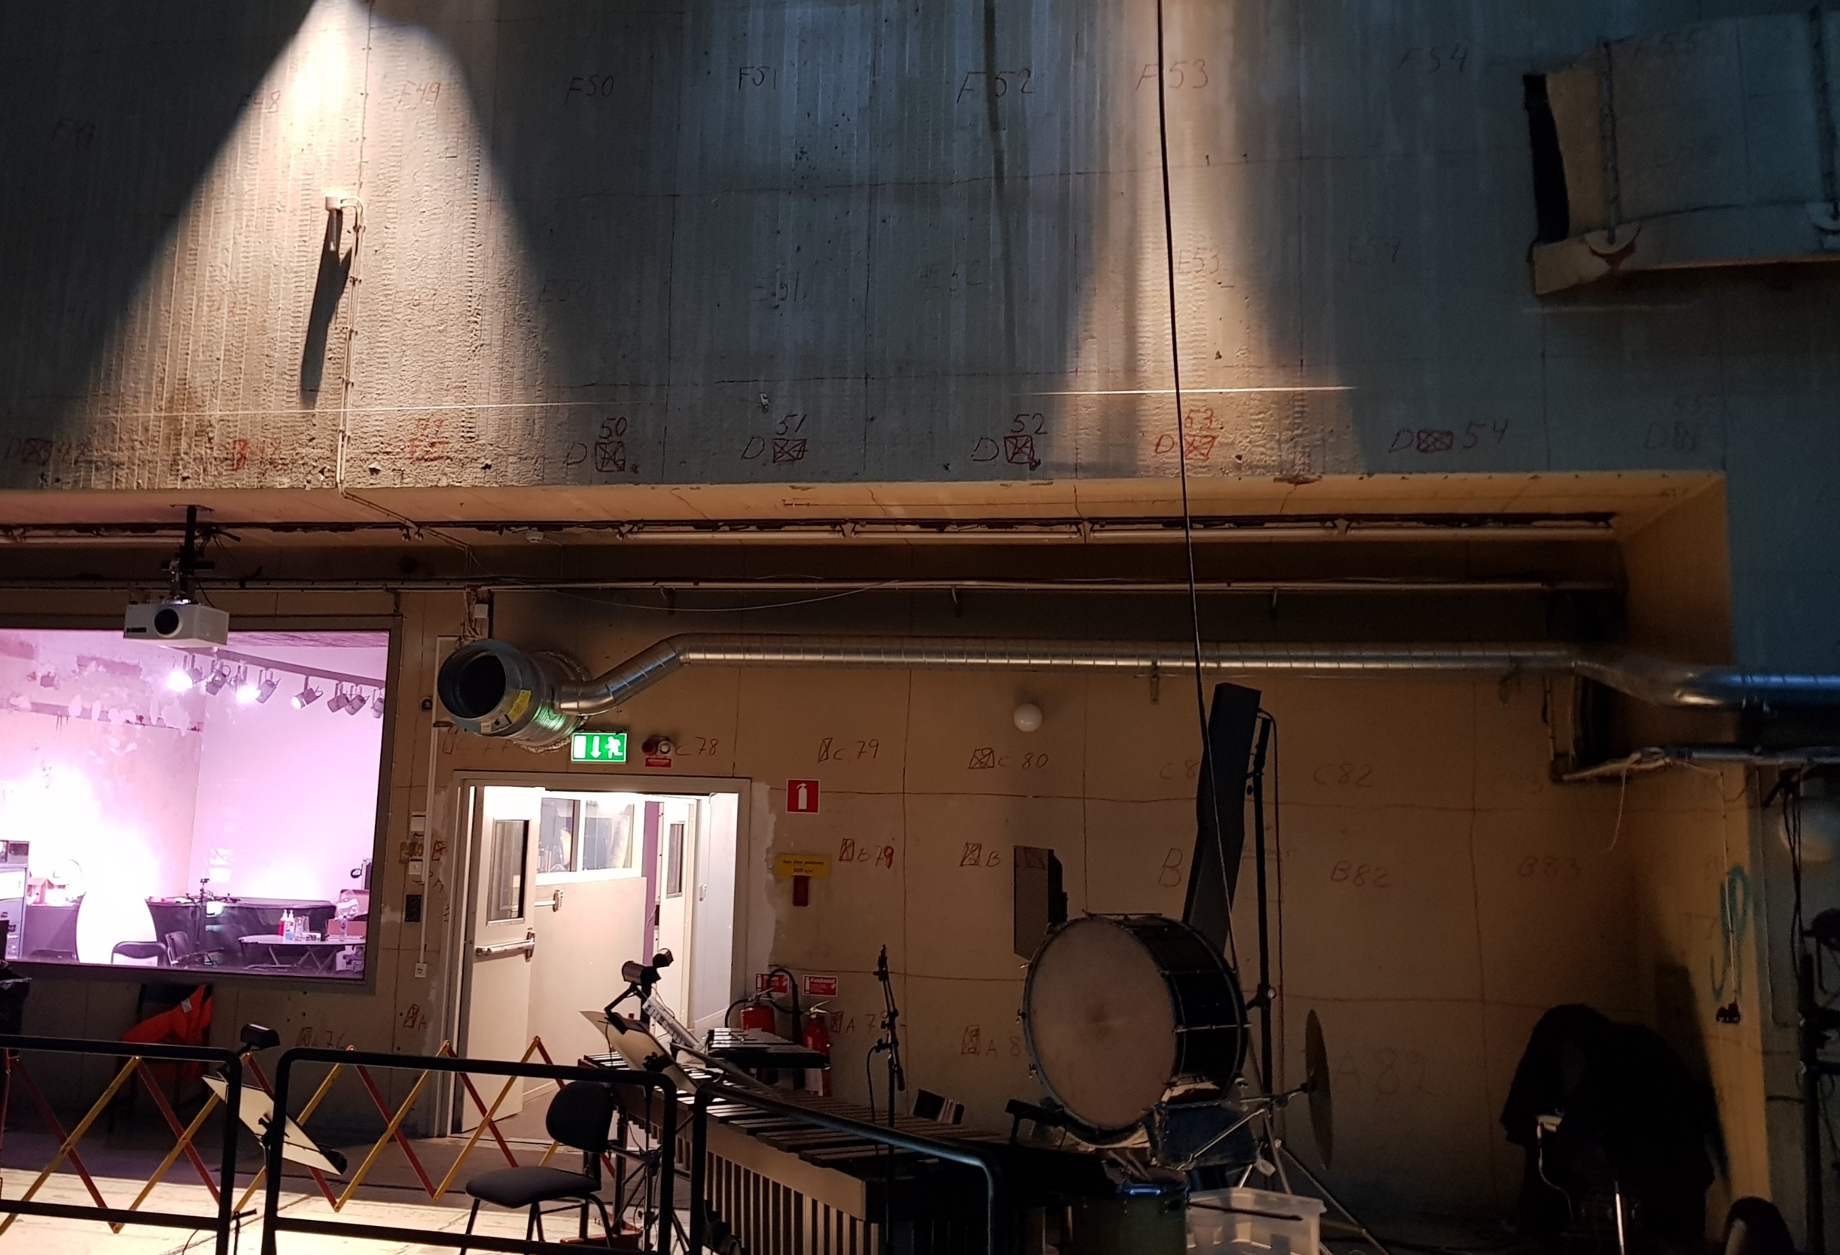
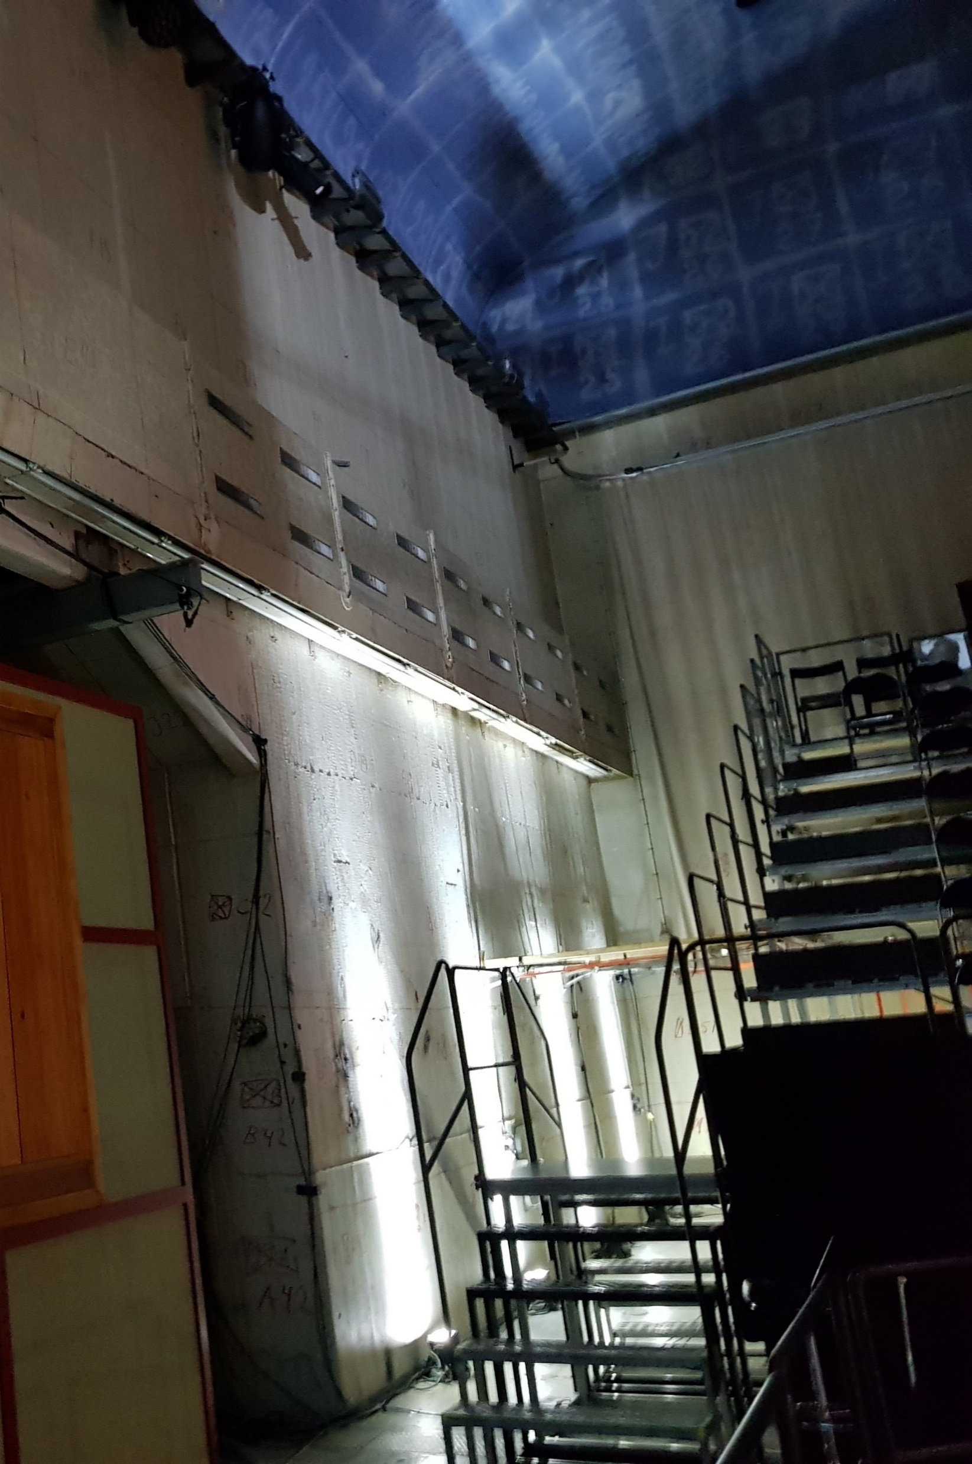
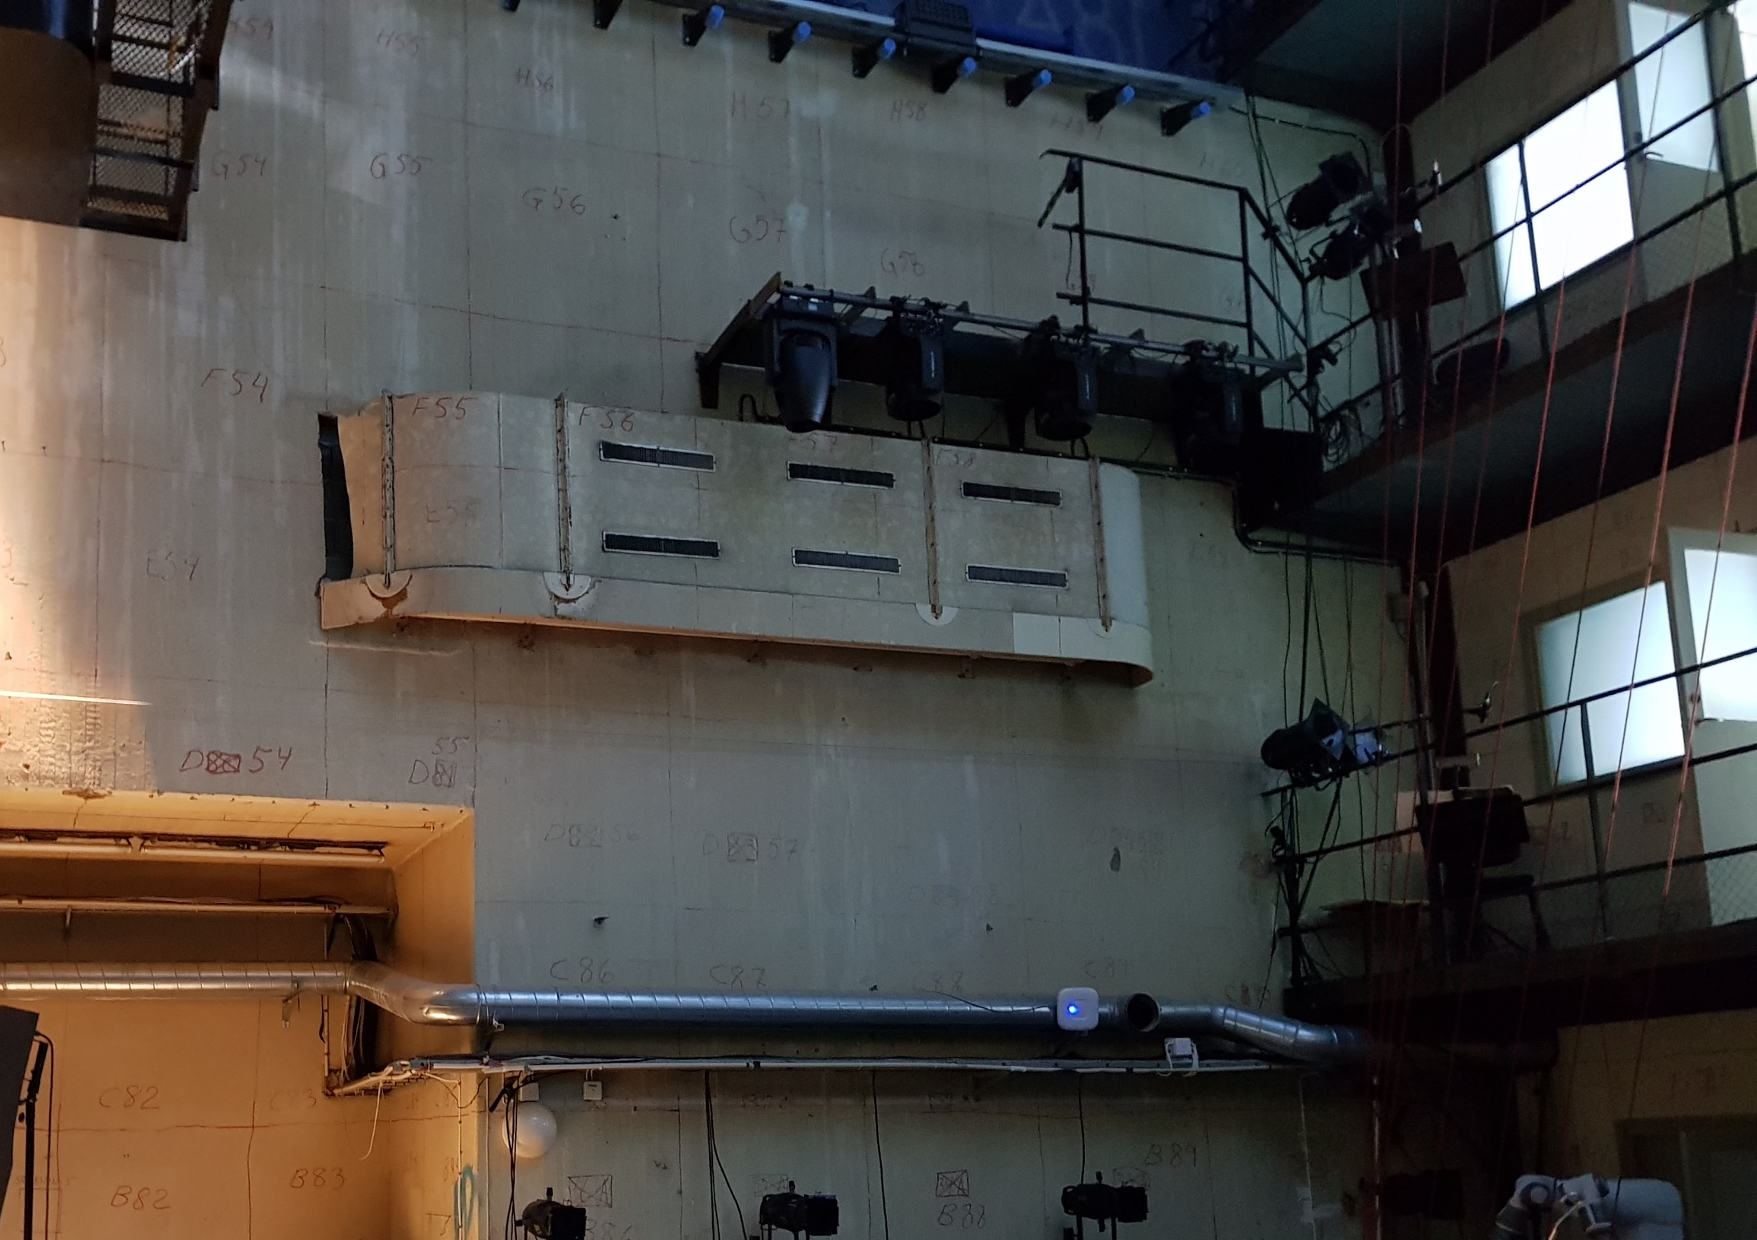
Low Location Nodes (2m height)
= Software Defined Radio (4x)
= Advantech Router (4x)
adv-08
adv-06
sdr-09
sdr-02
adv-03
adv-07
sdr-03

Slide 4
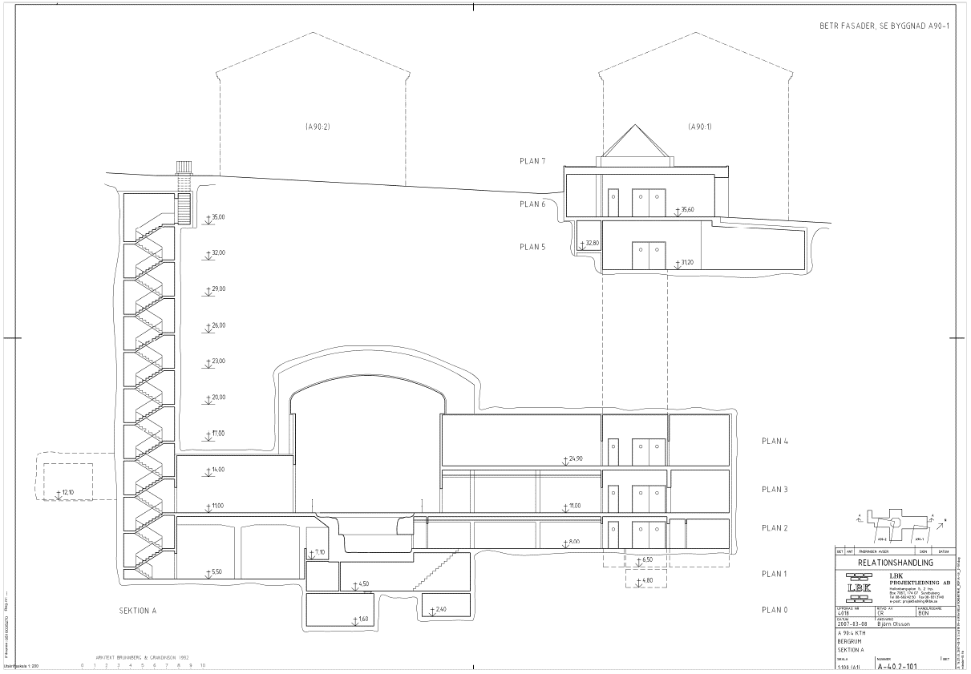

Slide 5
